Slide 1

EfficientNetB6-Based Fake and Propaganda Image Detection using AGSK Optimization
R.V. R. & J. C. College of Engineering
Batch Number –Y22CD/12
Under the Guidance of
Dr. M.V.P.CHANDRA SEKHKARA RAO
H.O.D
Dept. of CSD
Venkata Bhanu Teja Konijeti Y22CD079
Munnaluri Hanuman Sai Koushik Y22CD109
Kosuri Aarya Bhatt L23CD197
Medisetti Ravi Manikanta Ram Y22CD099

Slide 2
Contents
Abstract
Problem Statement
Literature Survey
Existing Work
Proposed Work
Block Diagram for Densenet121+agsk
Results for Densenet121+agsk
Block Diagram for Efficientnet-B6+agsk
Results for Efficientnet-B6 + agsk
Dataset
Methodology
Results Comparison
Conclusion & Future Scope
References
List of Publications

Slide 3
Abstract
Deepfake technology is a major threat to online security that allows for the production of highly realistic manipulated videos and images. Current detection methods tend to have difficulty generalizing because deepfake generation techniques keep changing. In order to tackle this problem, we introduce an enhanced deepfake detection system combining EfficientNet-B6 for stable feature extraction and Automated Adaptive Gaining Sharing Knowledge (AGSK) for adaptive hyperparameter tuning. The system is preprocessed by applying techniques like image normalization, resizing, data augmentation, and noise reduction to improve input quality. Capsule Networks are also utilized to preserve spatial hierarchies to enhance the classification accuracy. The suggested model is trained on a diverse set of data and achieves 99% training accuracy and 96% testing accuracy compared to traditional CNN-based models. This architecture provides a scalable and effective real-time deepfake detection method applicable in digital forensics, media authentication, and social media content moderation to prevent misinformation and confirm media authenticity.

Slide 4
Problem Statement
Deepfake and propaganda images have become a major concern as they are increasingly used to spread misinformation through highly sophisticated digital manipulations, making it difficult to distinguish them from authentic content. Existing detection methods often fall short in reliably identifying these manipulated images due to their high realism and the complexity of the alterations involved. To address this challenge, the paper proposes an automated deepfake detection framework that integrates the DenseNet121 architecture with an Adaptive Gaining Sharing Knowledge (AGSK) algorithm. This approach not only optimizes the model’s hyperparameters for enhanced feature extraction but also significantly improves accuracy and efficiency in distinguishing genuine images from deepfakes

Slide 5
Literature Survey
Research Title | Problem Statement | Existing Methodology | Parameters
Deep Neural Network-Based Detection of Facial Artifacts(2021) | Traditional feature extraction methods struggle to detect subtle alterations in deepfake images, leading to lower detection accuracy. There is a need for an adaptive model that can efficiently analyze facial artifacts and identify synthetic modifications. | Used a DNN to analyze facial artifacts, extract features, and classify real vs. fake images. | Accuracy: 86.30% Precision: 0.78 Recall: 0.77 F1 Score: 0.78
ANN-Based Deepfake Detection(2020) | Existing deepfake detection methods lack adaptability and fail to generalize across different manipulation techniques. An artificial neural network is required to recognize deepfake distortions efficiently. | Implemented an ANN to learn deepfake distortions and improve classification accuracy. | Accuracy: 89.50% Precision: 0.81 Recall: 0.79 F1 Score: 0.80

Slide 6
Literature Survey
Research Title | Problem Statement | Existing Methodology | Parameters
Adversarial Training for Deepfake Detection Using Generative Adversarial Networks (GANs)(2020) | Deepfake detection models often fail against high-quality deepfakes due to their limited ability to learn evolving deepfake techniques. A more dynamic and adversarial approach is needed. | Developed a GAN-based model using adversarial training to refine fake image detection. | Accuracy: 92.80% Precision: 0.84 Recall: 0.82 F1 Score: 0.83
Hybrid CNN-LSTM Model for Deepfake Detection (New Study)(2020) | Many detection methods lack the ability to capture both spatial and temporal features in manipulated videos. A hybrid deep learning model is needed for improved accuracy. | Developed a CNN-LSTM model that combines spatial feature extraction (CNN) with temporal pattern recognition (LSTM) to detect deepfake videos. | Accuracy: 89.50% Precision: 0.81 Recall: 0.79 F1 Score: 0.80

Slide 7
Existing Work
The paper proposes a deepfake detection model using Adaptive Gaining Sharing Knowledge (AGSK) algorithm with DenseNet121 to enhance feature extraction and classification. CapsuleNet is used to capture spatial relationships in images, while AGSK optimizes hyperparameters for better detection performance. The model processes images by removing noise, extracting key features, and classifying them as real or fake using a hierarchical DenseNet121 structure. The approach leverages deep learning and optimization to improve detection efficiency while reducing computational overhead.

Slide 8
Proposed Work
AGSK+EFFICIENT_B6 Approach
The proposed work introduces a deepfake detection model using the Adaptive Gaining Sharing Knowledge (AGSK) algorithm with EfficientNet-B6 to enhance feature extraction and classification. CapsuleNet is employed to capture spatial relationships in images, while AGSK optimizes hyperparameters for improved detection performance. The model processes images by removing noise, extracting key features, and classifying them as real or fake using the hierarchical structure of EfficientNet-B6. This approach leverages deep learning and optimization techniques to enhance detection efficiency while minimizing computational overhead, achieving 96% accuracy.

Slide 9
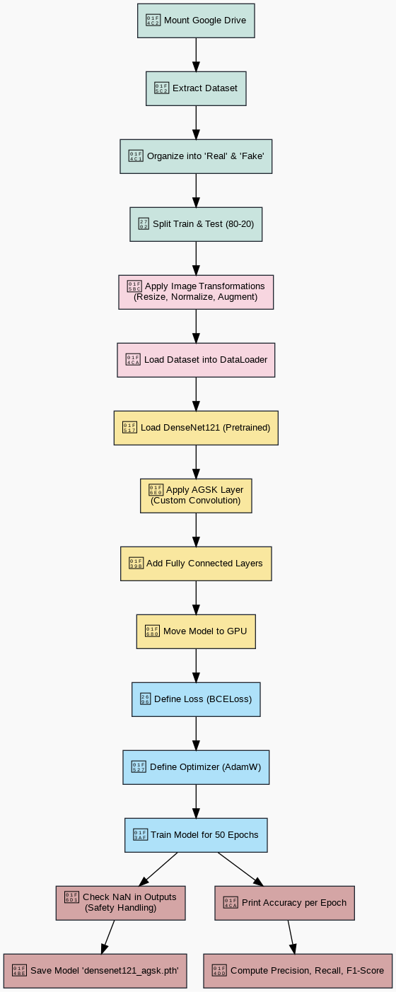
Block Diagram for Densenet121+Agsk

Slide 10
Results for AGSK+DENSENET121
Parameters | Values
Accuracy | 93%
Precision | 0.85
Recall | 0.92
F1 Score | 0.88

Slide 11
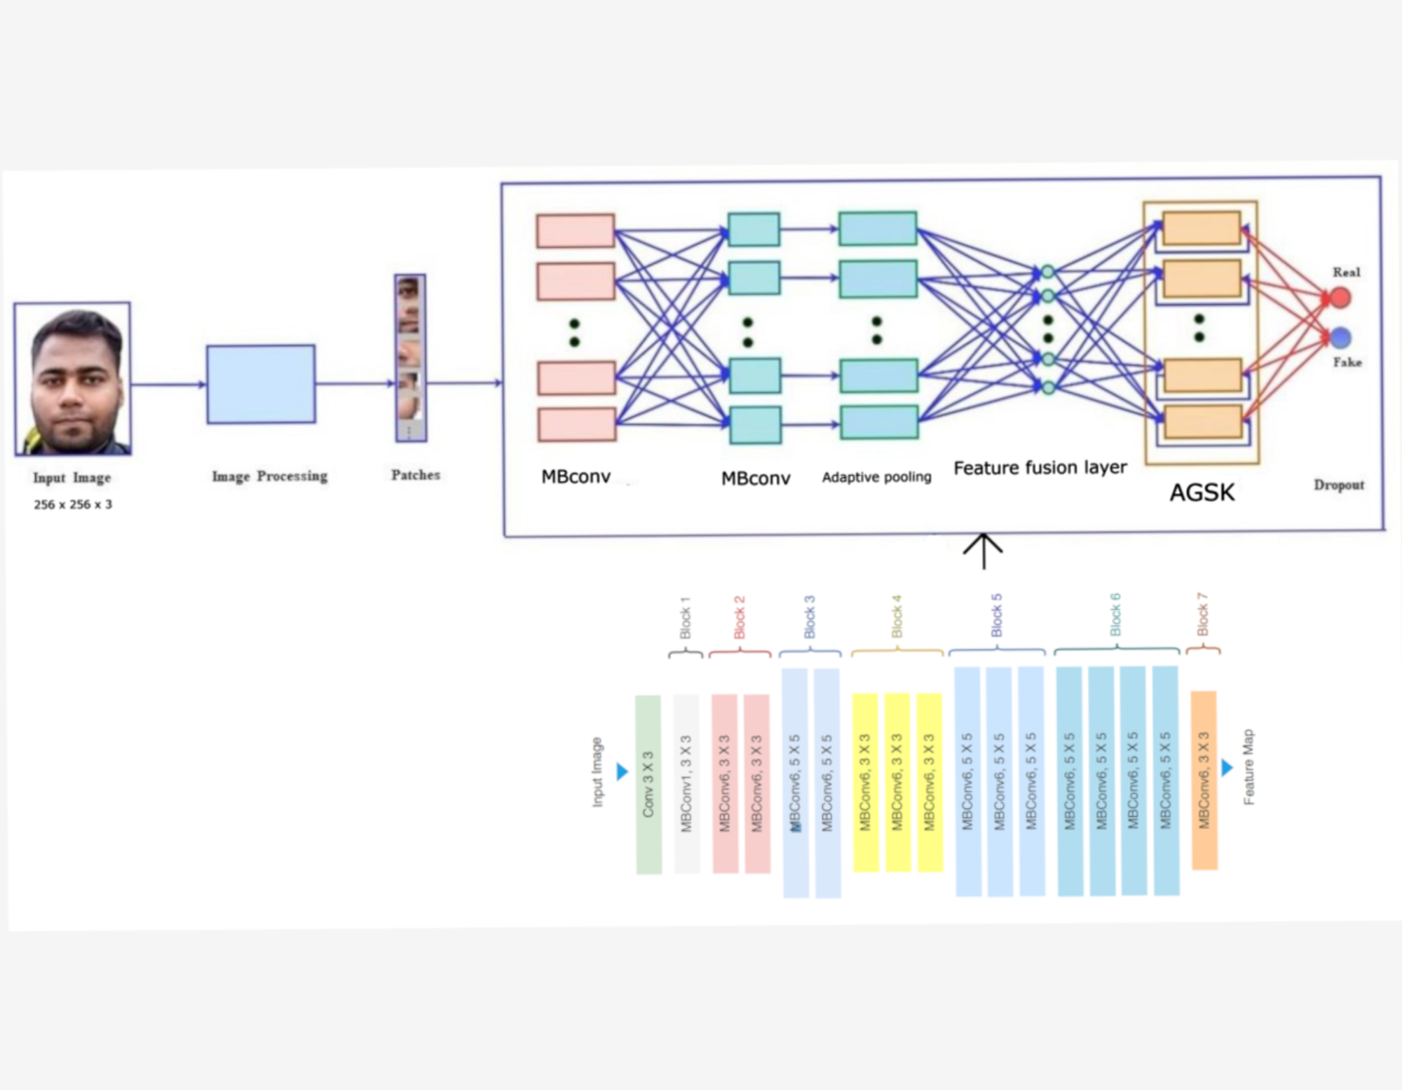
Architecture For Proposed work

Slide 12
Results for AGSK+EFFICIENT-B6
Parameters | Values
Accuracy | 96.58%
Precision | 0.96
Recall | 0.95
F1 Score | 0.96

Slide 13
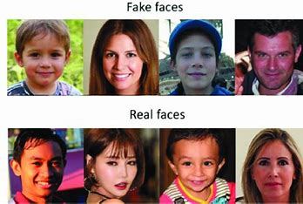
Dataset
Dataset

Slide 14
Methodology
1. Data Acquisition
Extract the dataset from a ZIP file stored in Google Drive.
Organize images into real and fake categories.
2. Data Preprocessing
Resize images to 256×256 for efficient computation.
Apply random transformations (flipping, rotation, color jitter) to enhance model robustness.
Normalize pixel values to [-1, 1] for stable training
3. Feature Extraction
Utilize CapsuleNet to extract high-dimensional feature vectors.
Preserve spatial relationships between image features.
4. Model Training
Use EfficientNet-B6 as the backbone for feature extraction.
Integrate AGSK for dynamic hyperparameter optimization.
Train with Binary Cross-Entropy loss and AdamW optimizer.
.

Slide 15
5. Model Evaluation
Plot learning curves for loss and accuracy.
Generate a confusion matrix.
Compute F1-score, Accuracy, Precision, and Recall for performance evaluation.

Slide 16
Results Comparison
Model | Accuracy | Precision | Recall | F1 Score
DENSENET121+AGSK | 93% | 0.85 | 0.92 | 0.88
EFFICIENT-B6+AGSK | 96% | 96 | 95 | 96
CNN | 75% | 75 | 70 | 72
ResNet18 | 85% | 85 | 80 | 82

Slide 17
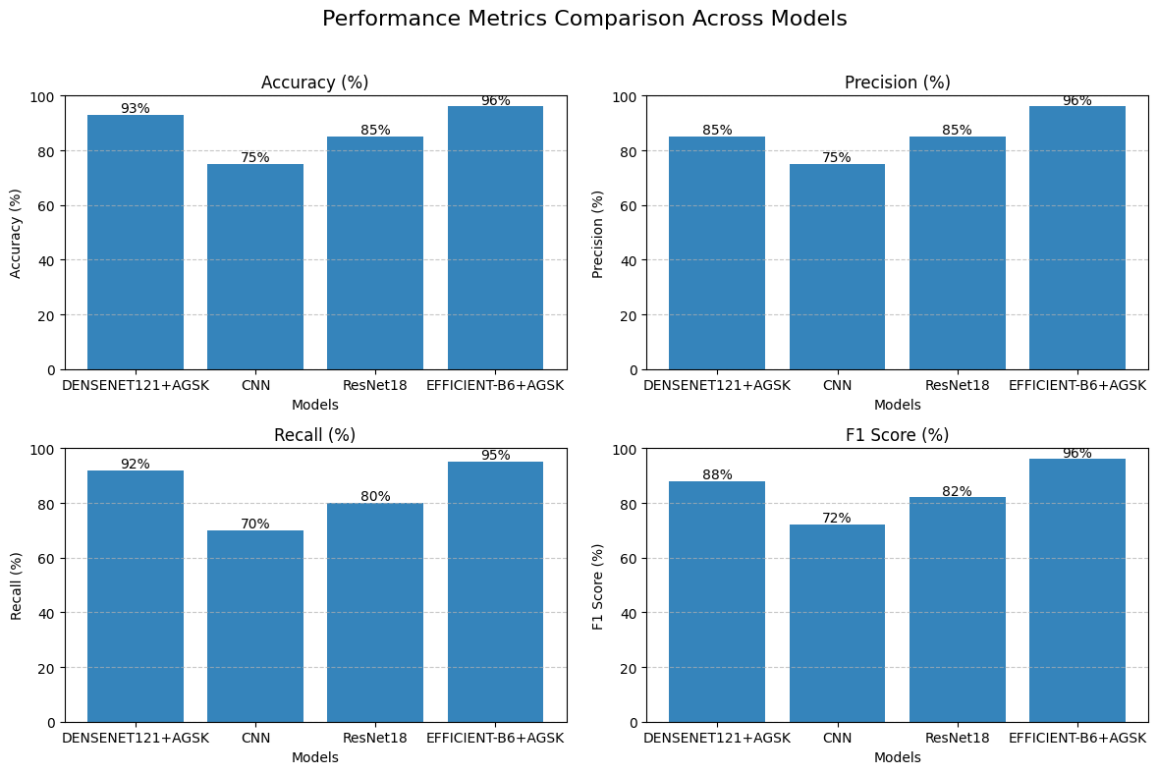

Slide 18
Conclusion & Future Scope
The proposed deepfake detection model combines AGSK with EfficientNet-B6 for improved classification, leveraging CapsuleNet for feature extraction and AGSK for hyperparameter tuning. Achieving 96% accuracy, it proves effective in distinguishing real and fake images, validated through F1-score, Precision, Recall, and Confusion Matrix. Future work includes real-time detection, lightweight deployment,cross-dataset generalization, Explainable AI (XAI) for interpretability, and adversarial attack resistance to enhance robustness.

Slide 19
References
[1] https://ieeexplore.ieee.org/document/9143097
[2] https://ieeexplore.ieee.org/document/9105097
[3] https://ieeexplore.ieee.org/document/9115874
[4] https://www.researchgate.net/publication/351263839_Gaining-Sharing_Knowledge_Based_Algorithm_With_Adaptive_Parameters_for_Engineering_Optimization
[5] https://www.researchgate.net/publication/348033118_Deepfake_Detection_through_Deep_Learning
[6]https://www.researchgate.net/publication/365254218_Hyperspectral_Image_Classification_Using_3D_Capsule-Net_Based_Architecture
[7] https://sci-hub.se/downloads/2021-05-14//27/serengil2020.pdf
[8]https://www.researchgate.net/publication/352765531_Detecting_fake_images_by_identifying_potential_texture_difference
[9]https://www.researchgate.net/publication/341329841_A_New_Deep_Neural_Architecture_Search_Pipeline_for_Face_Recognition
[10] https://www.researchgate.net/publication/349851883_Making_Sense_of_Blockchain_for_AI_Deepfakes_Technology

Slide 20
Thank You

